Slide 1



Color Correction for Optical See-Through Displays Using Display Color Profiles
Srikanth Kirshnamachari Sridharan
Dr. Juan David Hincapié-Ramos
Dr. David R. Flatla (University of Dundee)
Dr. Pourang Irani
Notes:
A very good afternoon.
My name is Srikanth Kirhsnamachari Sridharan,
I am a Masters student at university of Manitoba Canada.
Yes I here from half the way across the globe,
The papers I am present is titled “Color Correction for Optical See-Through Displays Using Display Color Profiles”
This work is part of m masters thesis.
Collaborators on in this work are
Dr. Juan David Hincapié-Ramos
Dr. David R. Flatla (University of Dundee)
Dr. Pourang Irani
For this work

Slide 2
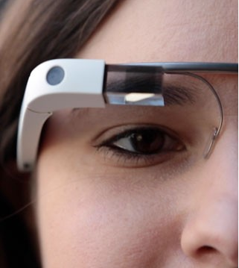
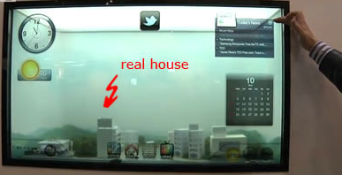
Introduction
Optical see-through displays (OSTD) allow users to view digital content and physical objects simultaneously.
Additive OSTD: Has its own light source
Subtractive OSTD: Filter external light source
Notes:
Jumping into the talk ,
Optical see-through displays or as we call OSTD - allow users to view digital content and physical objects simultaneously
OSTD are of 2 types
Additive & Subtractive
Advantage of having its own light source enables Additive OSTD to have Hardware's of different form factors such as mobiles, HMD, window based displays!

Slide 3
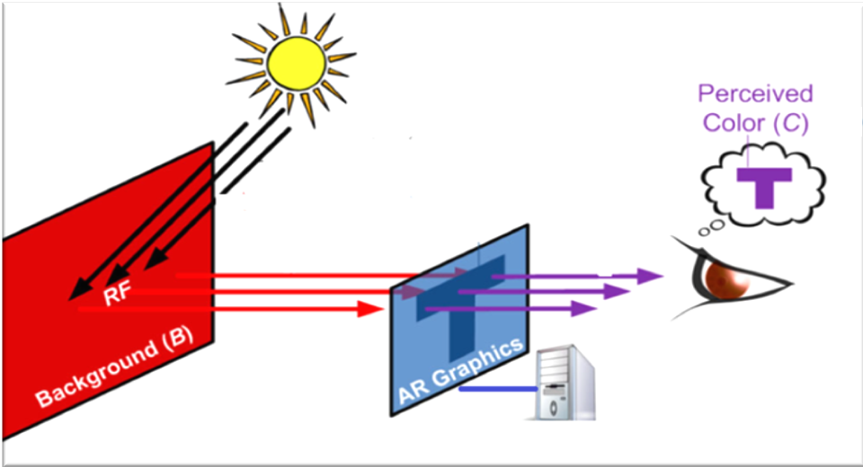
Gabbard et al - More than meets the eye: An engineering study to empirically examine the blending of real and virtual color spaces , VR 2010
Real world background color affects the displayed contents on the digital display
Notes:
However additive OSTD has a problem!
The real world background color mixes with the displayed color.
This phenomenon cause the users perception of the color being displayed to changes from what the color originally is !
Color are essential to clarity of the display, colors help humans to clearly understand the contents on the display.
Color blending negatively affects the usability of such displays as it impacts the legibility and color encodings of digital content.

Slide 4
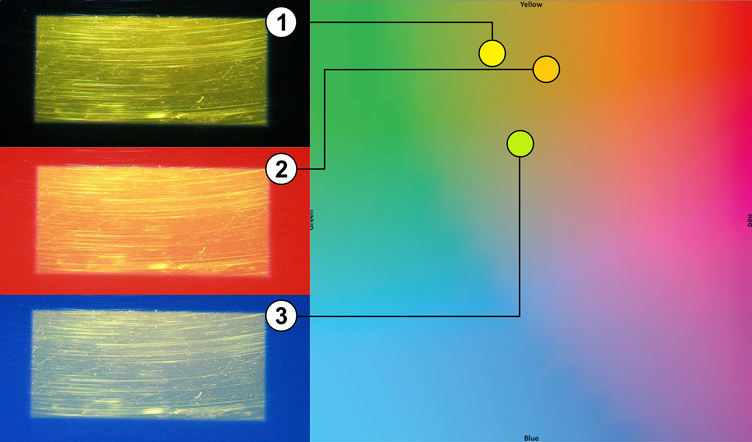
Notes:
This image shows color blending effort on the digital color yellow ,
Here is a OSTD displaying color yellow in 3 different background,
Black background- to the right in the color map you can see yellow being – yellow!
On red background- to the right in the color map you can see yellow being – moved towards red( shows orange)
Blue background-to the right in the color map you can see yellow being – moved towards green

Slide 5
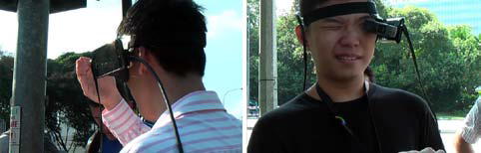
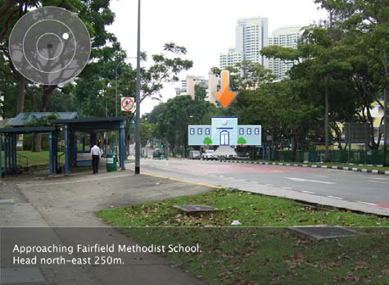
Usability Problem
Kerr et al , Wearable mobile augmented reality: evaluating outdoor
user experience. VRCAI ’11
Notes:
This efforts of background has been studied before by various researchers mostly in the field of Augmented reality.
On usability issues and human perception
One such Eg is,
Kerr et al 2011, studies outdoor use of AR system, where they found on heavy influence from the background users used their hand on have a consistent bg to look at the contents !!
This shows that this influence of the background is a significant problem

Slide 6
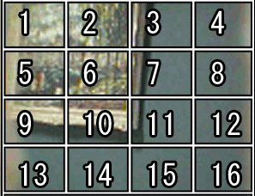
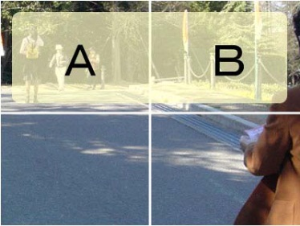
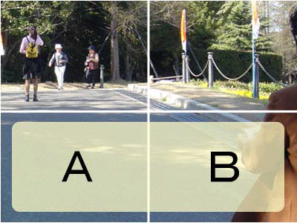
Content Based Solutions
Tanaka et al, An information layout method for an optical see-through head mounted display focusing on the view ability. ISMAR 08
Notes:
Tanaka et al. developed a layout system that relocates digital content to the darker areas of the display taking.
This methods might result in constant shift of the digital content for dynamic background.

Slide 7
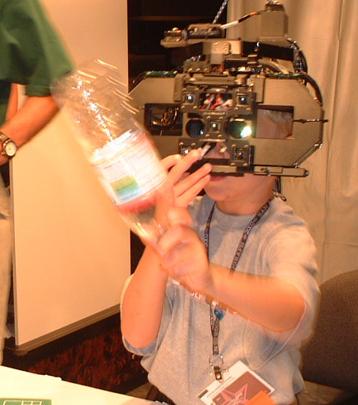
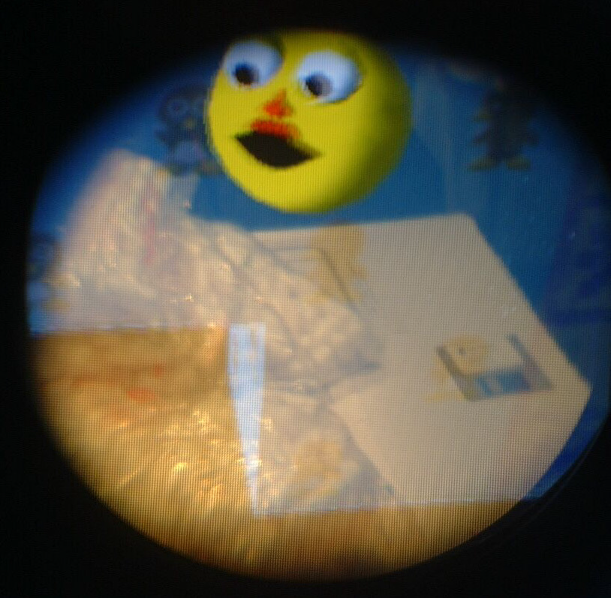
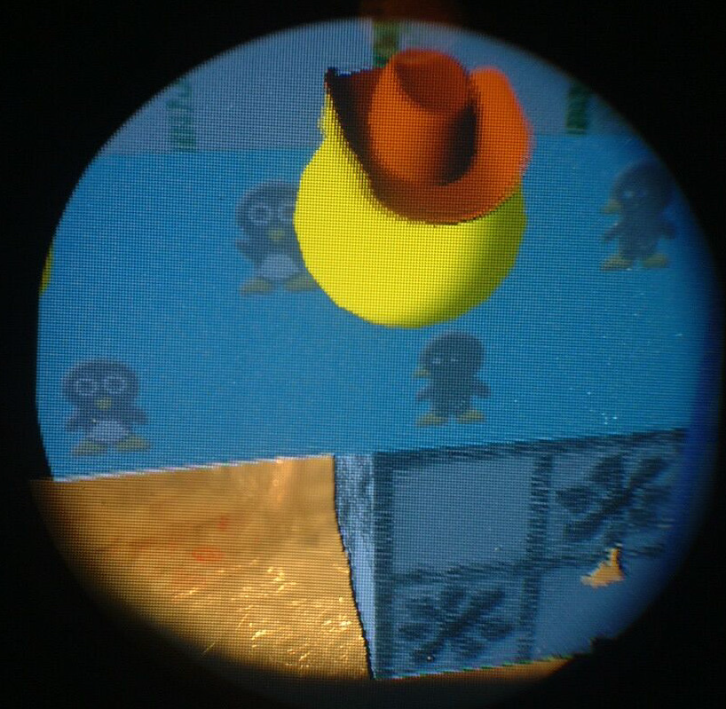
Hardware Based Solution
Kiyokawa et al, An Occlusion-Capable Optical See-through Head Mount Display
for Supporting Co-located Collaboration. ISMAR 2003
Notes:
The main approach to occlusion has been to stop the light coming from the background by enhancing head-mounted displays with spatial light modulation (SLM) devices
Therefore, digital colors projected on the black areas are seen in their original hue and lightness. draw backs being the excess hardware and unavailability of the BG.
(clearly they were not going for style)

Slide 8
How We differ ?
Notes:
We aim not to change the location of UI elements
or
Add new hardware components
We wanted to manipulate the color shown by the display; an approach known as Color Correction.

Slide 9
Color Correction
Involves in the system finding an alternate digital color which, upon blending with the background comes closer to the desired digital color
Notes:
Read out “Involves in the system finding an alternate digital color which, upon blending with the background comes closer to the desired digital color”

Slide 10
Background
To pick a alternate color we need ability to predict how colors blend on a given display.
We propose a new color blending model that can predict how colors blend on a OSTD
Notes:
Point 1:
To pick a alternate color we need ability to predict how colors blend on a given display.
Without which we cannot really say how the alternate color will look once it blends with the BG.
Point 2:
We propose a new color blending model that can predict how colors blend on a OSTD.
This model is very unique to OSTD, as it address unique problems which are present in OSTD

Slide 11
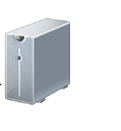
F(
Bg Color
Background
fmaterial
frender
Blended Color
Blended Color = frender(Digital Color) + fmaterial(Bg Color)
Digital Color
Notes:
Every display shows color a bit different , this is more pronounced in OSTD as each display has different display material, light source etc.
As you can see here the color blue shown is slightly changed when its shown on the display. In our model we account for this change render distortion function.
Similar the OSTD display material changes the color of the BG as it shown here with change in hue of bg color red . We count this by the material distortion function.
We argue in this work the color Belding is a mix of these distorted color than the original colors !!

Slide 12
Contribution
A new Color blending Model for OSTD
Binned Profile (BP) – To handle Render Distortion
BP Based Color Correction
Design guidelines for OSTD
Notes:
So what is our contributing visa this work ?
A present a new Color blending Model for OSTD
Binned Profile (BP) – To handle Render Distortion
BP Based Color Correction
Design guidelines for OSTD

Slide 13
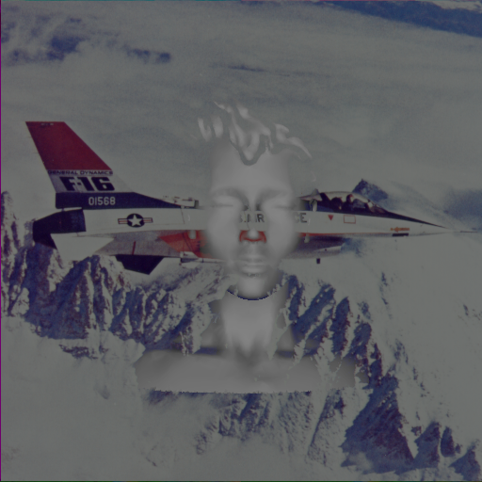
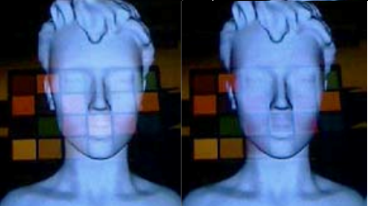
Color Correction in OSTD
Weiland et al, Colorimetric and photometric compensation for optical see-through displays.
Notes:
There are number of works on color correction on spatial augmented reality , in like of projection on textured surface.
But in OSTD the only existing work on color corrections is by
Weiland et al, Colorimetric and photometric compensation for optical see-through displays.
Drawbacks
Their Work Ignores both the distortions
They used sRGB space for color calculations- in which colors accuracy cant be tested
They used Color Subtraction ( Show the second image’s empty spots)

Slide 14
Experimental Test-Bed
Notes:
We build a test best to generate a wide variety of Fg and on a standard set of backgrounds , to conduct our study in wide range of fg –bg color combinations.

Slide 15
Projection based
A view control film called Lumisty(MFY 2555) was used to create the transparent screen
Two different projectors were used:
Epson 1705 with 2200 lumens
Epson VS35ow with 3700 lumens
Notes:
2 projections based displays ,
Each with a projector of difference lumens -2200 and 3700 called as p22-hundred and p-37-hundred
The transparent material was made up view controlled sheet called Lumisty.

Slide 16
T-OLED
Notes:
For T-OLED we used Lenovo s800 phone’s display

Slide 17
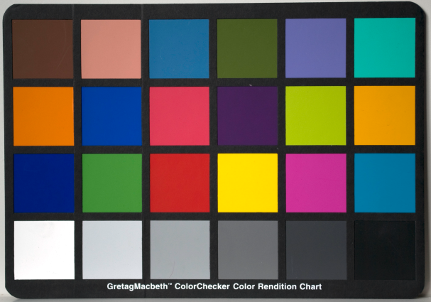
Background colors for experiment
Picture from Wikipedia
23 Macbeth chart colors used as background
Notes:
We used a standard sRGB capable Dell monitor to reproduce 23 megbeth chart colors.
We chose these colors cause they are well spread in the sRGB gamut range, with enough high and low intensity colors.
A monitor was used instead of real-world background because, we needed to have exact measurement of our bg colors which will remain consistent when reproduced in a calibrated monitor.
Also monitor gave us access to uniform diffusion of the BG color.

Slide 18
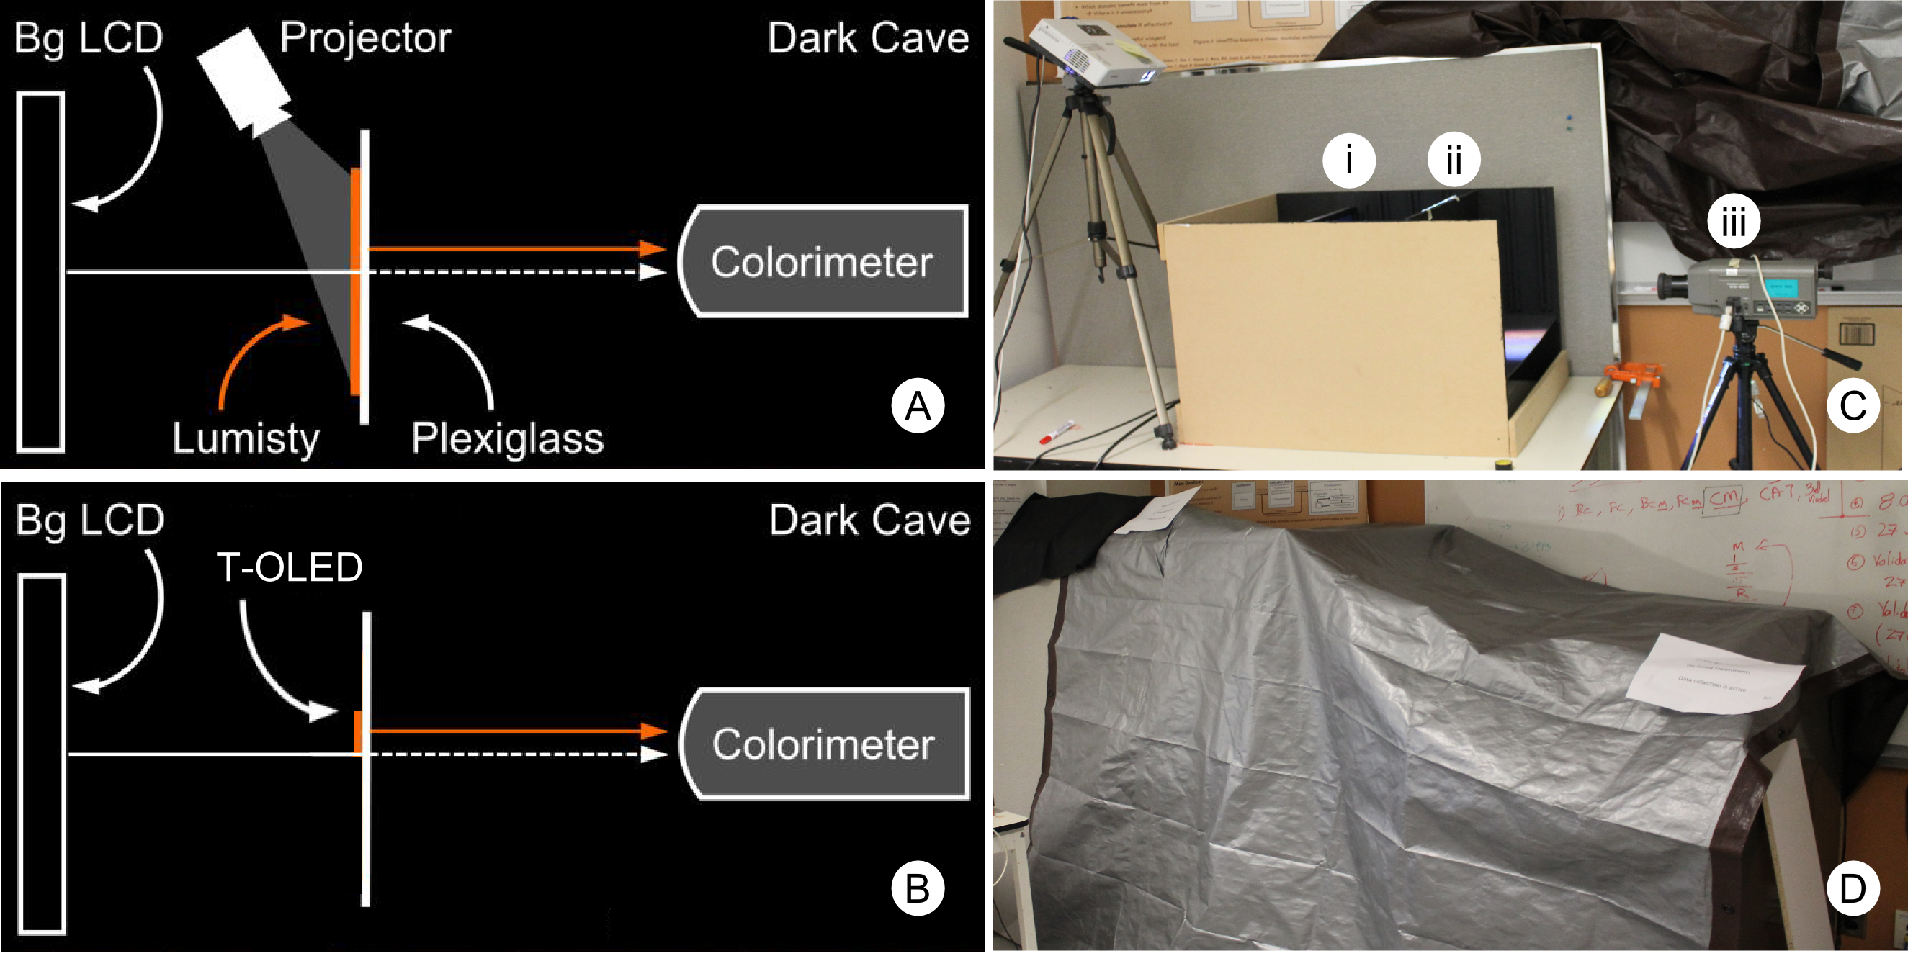
Setup
Notes:
Image on the left shows how the set up was for both projection based and TOLED
Image on the right © shows how the actual setup was.
And image d shows the out light controlled environment
We used cs200 colorimeter to measure the color values.

Slide 19
Binned Profile
Notes:
We propose binned profile to account for the render distortion

Slide 20
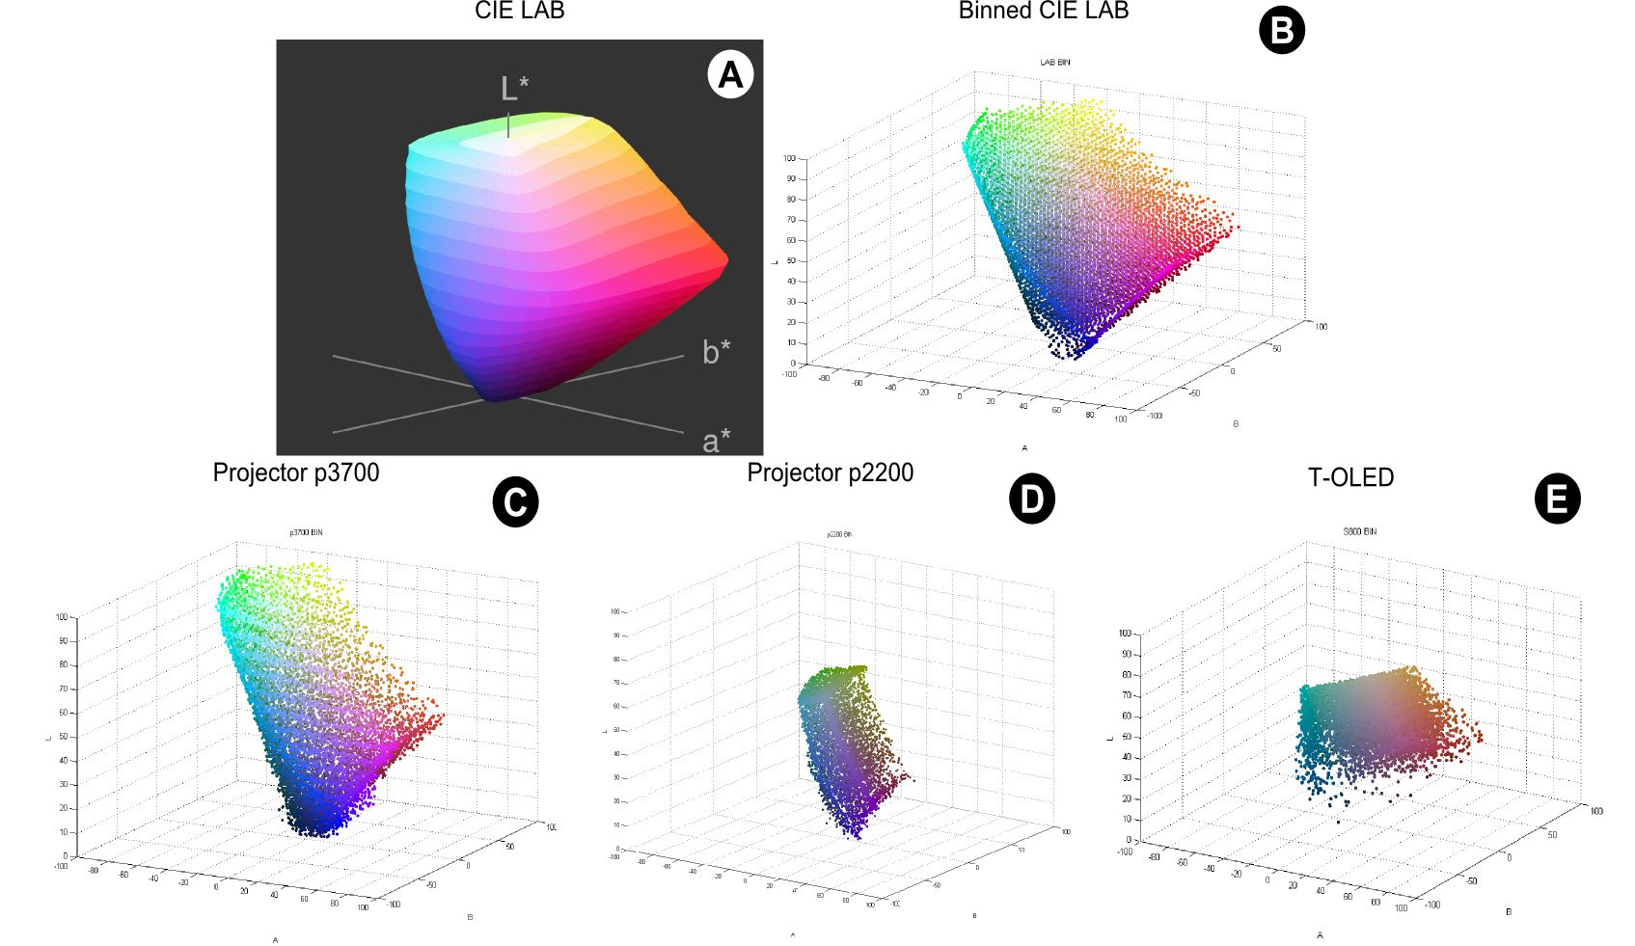
sRGB colors in LAB space
8376 Binned representative sRGB
p3700
p2200
T-OLED
Notes:
Divides sRGB color space (over 16 million colors) into a smaller set of 8376 perceptually different bins.
We translated the sRGB gamut into the CIE LAB color space and divided it into bins of 5X5X5
This approach guaranties all colors inside a bin are within one Just Noticeable Difference (1 JND ~ 2.3 in Euclidean distance)
we measured how each bin is rendered by each of our three displays on a black background which is shown here for all 3 displays
P37-hundred had a wide color space and close to sRGB when compared to p2200 and TOLED
Create a look up table which is Binned Profile

Slide 21
BP Method Color prediction
Binned Profile
Foreground
Measured foreground
Background
Measured foreground in binned profile
Prediction
Notes:
We had bp which is a look up table, where we had measurements for all 8000 odd colors ,
So when we wanted to predict how a particular fg will blend with bg , we go into the bp to see how that fg color looks,( I this case color red)
Then add the measured value present in the fg table with the bg , to predict the color
Then we also showed the same color pair in our experimental set up to

Slide 22
Color Prediction Model
We tested the validity of this method against
Direct Method
CAT Method
Notes:
Direct Method:
Synonymous to Weiland et al work
The digital color is simply added to the background
It ignores both render and material distortion
CAT
CAT are established methods to estimate the colors a display can render based on the brightest white it can emit. They are based on matirc converstions
In other words we hoped that they could potentially handle render distortion

Slide 23
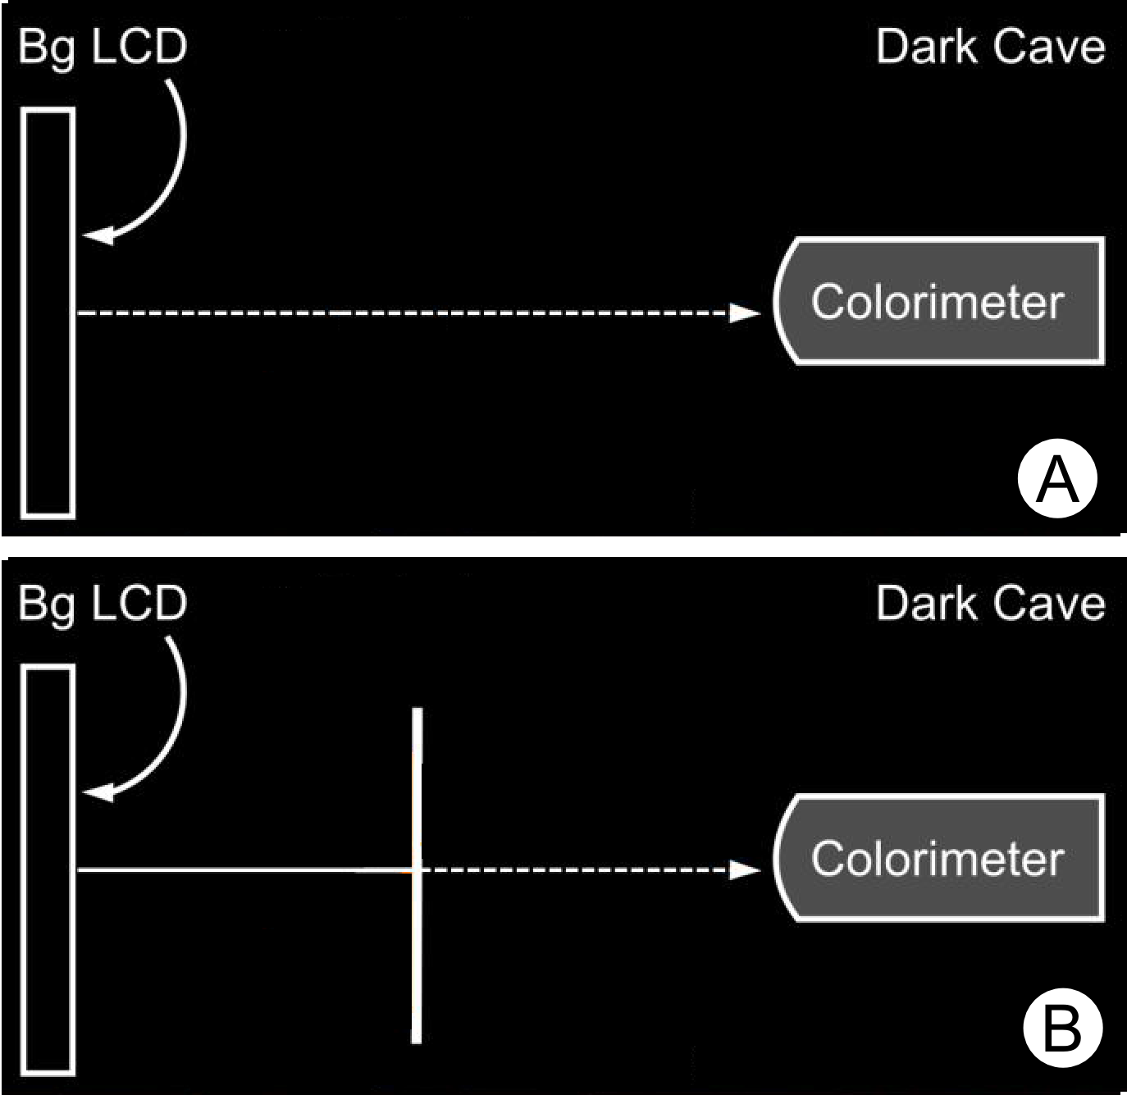
Background Configuration
Plain Configuration
Adjusted Configuration
Notes:
We capture the bg in 2 config, one directly as the bg is , called plain config
2 bg as seen through the OSTD , called adjusted config.
Adjusted config was captured to handle material distortion

Slide 24
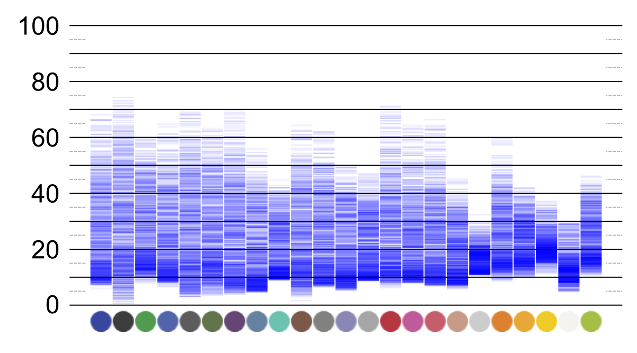
Result Visualization
Notes:
We used 838 fg colors on each of our 23 bg colors, measured the blend.
Calculated error value by finding color difference between predicted and measured in Lab.
This visualization shows prediction error value for one condition across 23 bg on for all 838 fg colors
Hager the hue of blue indicates more value fell in that region .
Error rate at the bottom near 0, represent prediction with low error rate

Slide 25
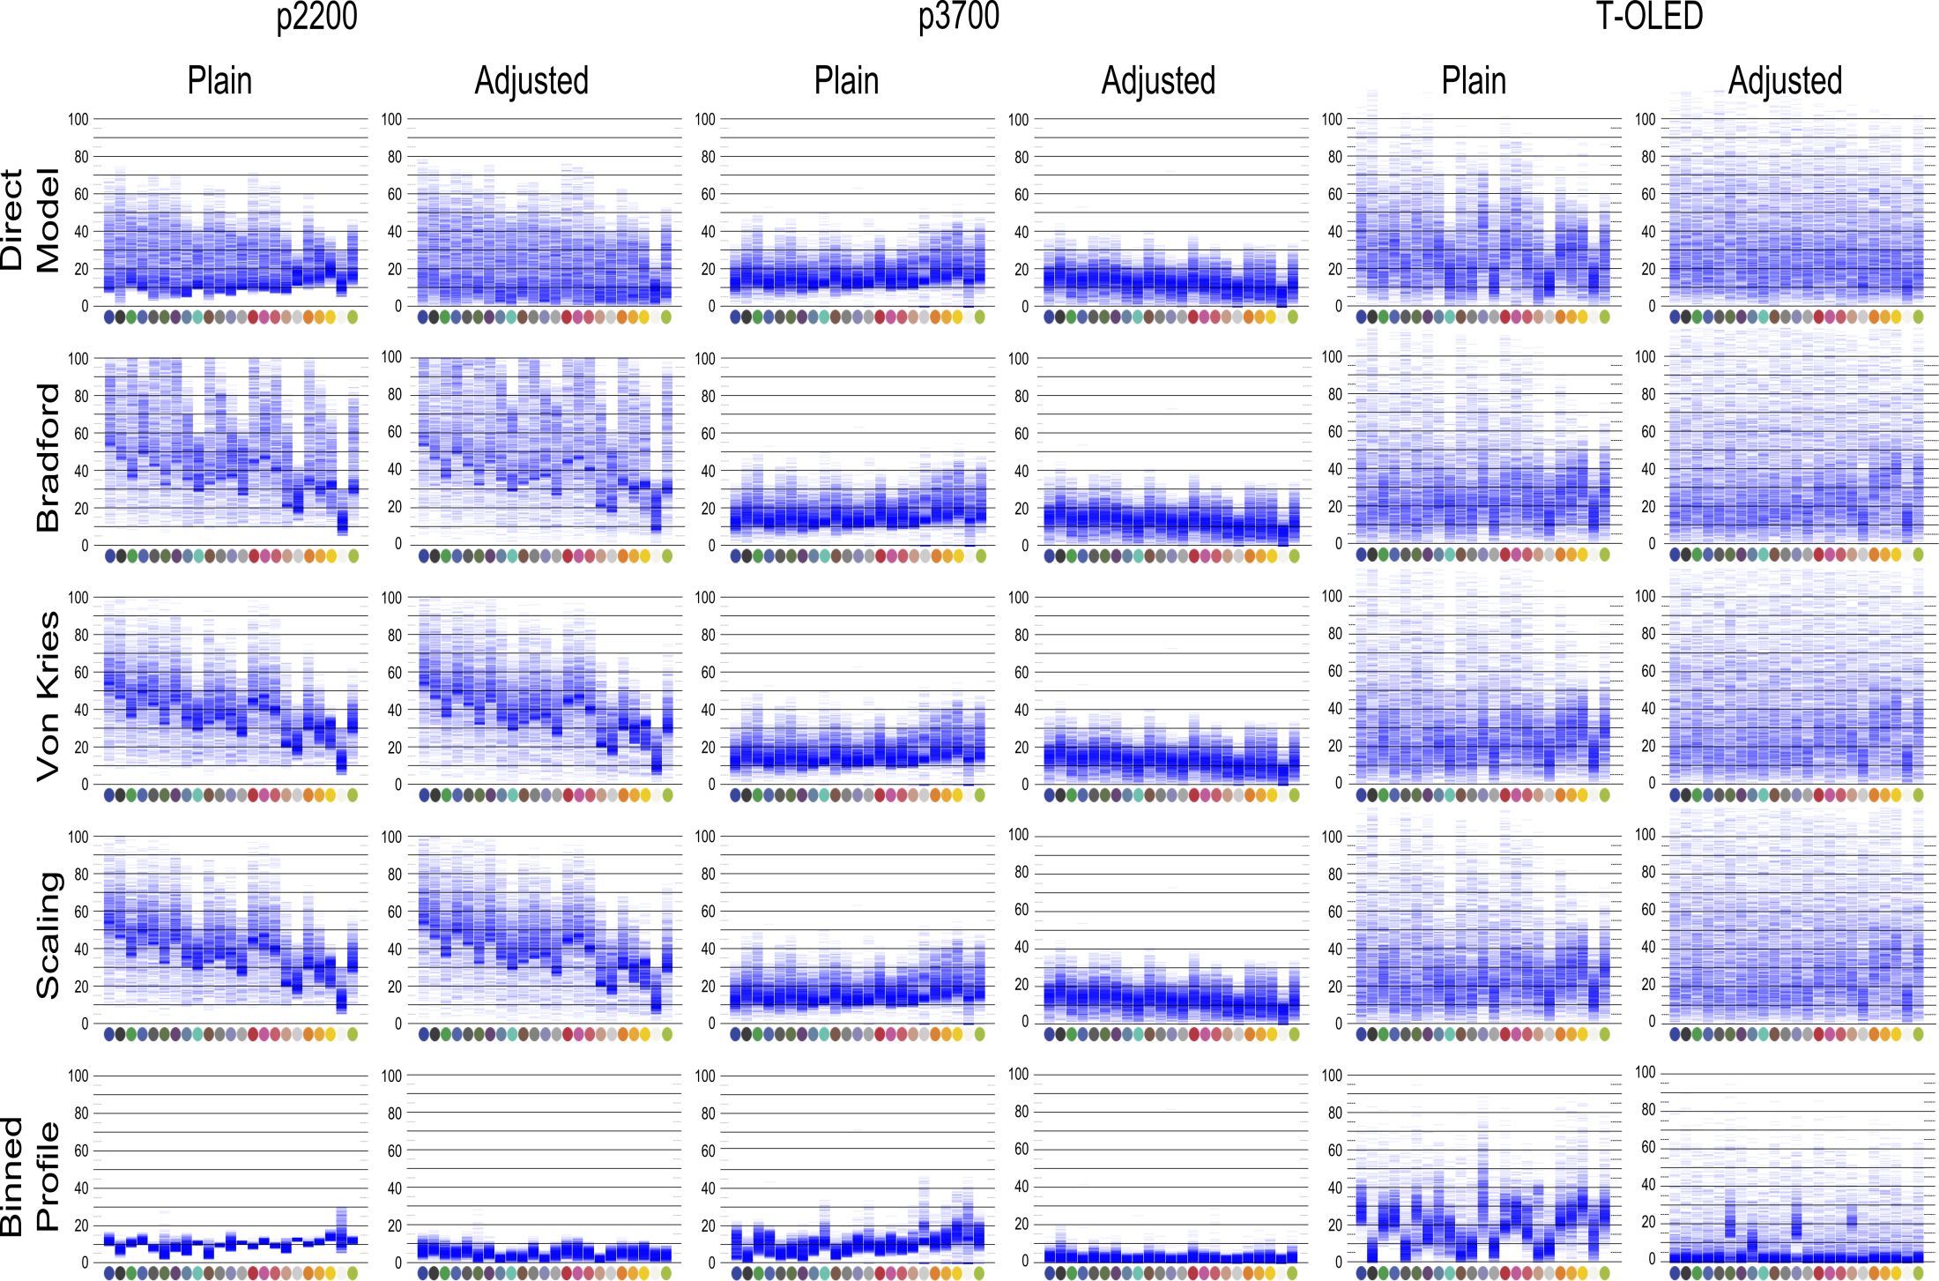
Notes:
This visualization was used to compare the 5 models we had, over 3 displays in 2 different bg config
Bp In all cases was found to be the most accurate in predicting the blend
Cat , which we hoped will account for the render distortion failed to do so , having high spread in error

Slide 26
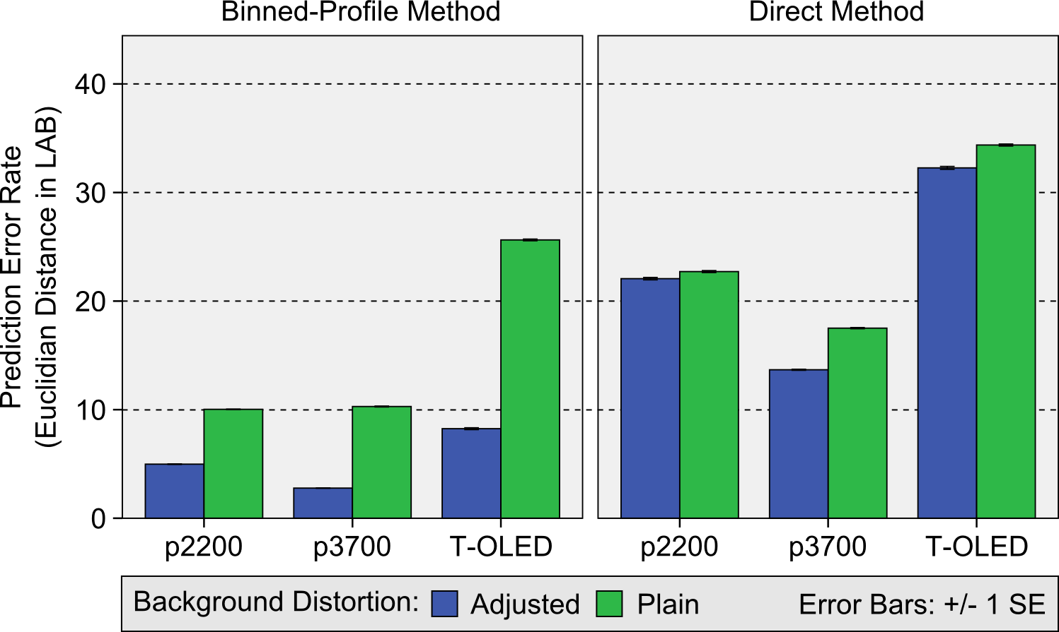
Quantitative analysis
Kruskal-Wallis test was done, Sig <0.001
Notes:
We decided to do quantitative analysis for bp and direct model.
Here green bars rep bg in plain config, blue bars rep bg in adjusted config
Graph shown there is a fall in green pars perdition error between bp and direct model for all 3 displays.
This shows accounting for render distortion with the help of bp decreases the prediction error.
While both the distortions were accounted for the prediction accuracy increased as shown in the graph comparison between plain and adjusted config using bp on all 3 displays.
However addressing only the material distortion , does little change to the error rate
this result shows the render distortion constitutes the core of color blening in OSTD

Slide 27
Color Correction
We developed a color correction algorithm based on BP method
Input to this algorithm is BP of that OSTD, Desired foreground color, Background Color
Notes:
We developed a color correction algorithm based on BP method
Input to this algorithm is BP of that OSTD, Desired foreground color, Background Color
This algorithm compares every color in the bin before it picks the best one which on blending comes closest to the desired fg color

Slide 28
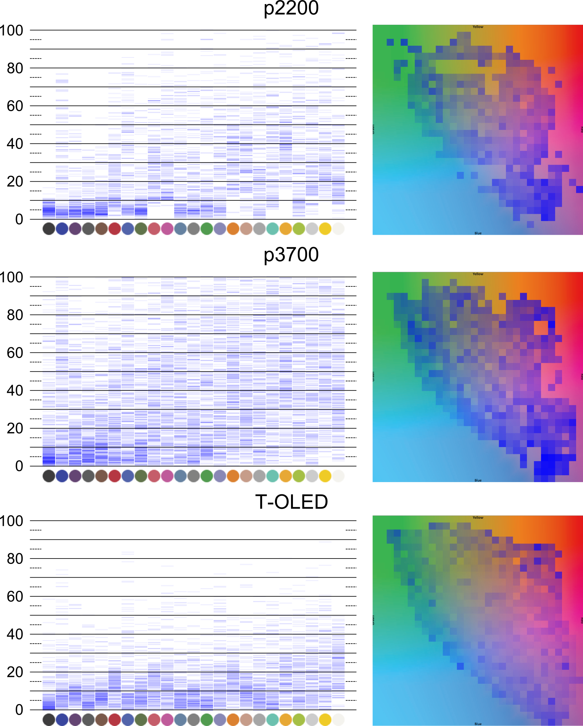
Result
Notes:
We created correction heat maps for all 3 displays,
The heat map shows generally colors for p22-hundered and TOLED were better corrected than the p3700
This is due the both these displays have limited color profile, so the distqance between a color to shown in bin and how it measured fg will always be small.
We also found a trend in fg color always got corrected better for low intensity bg , with the correction error increasing with the intensity of the bg.
We took the p3700 and studied it further has it had wider range colors , which are typlically needed for rich multimedia contests

Slide 29
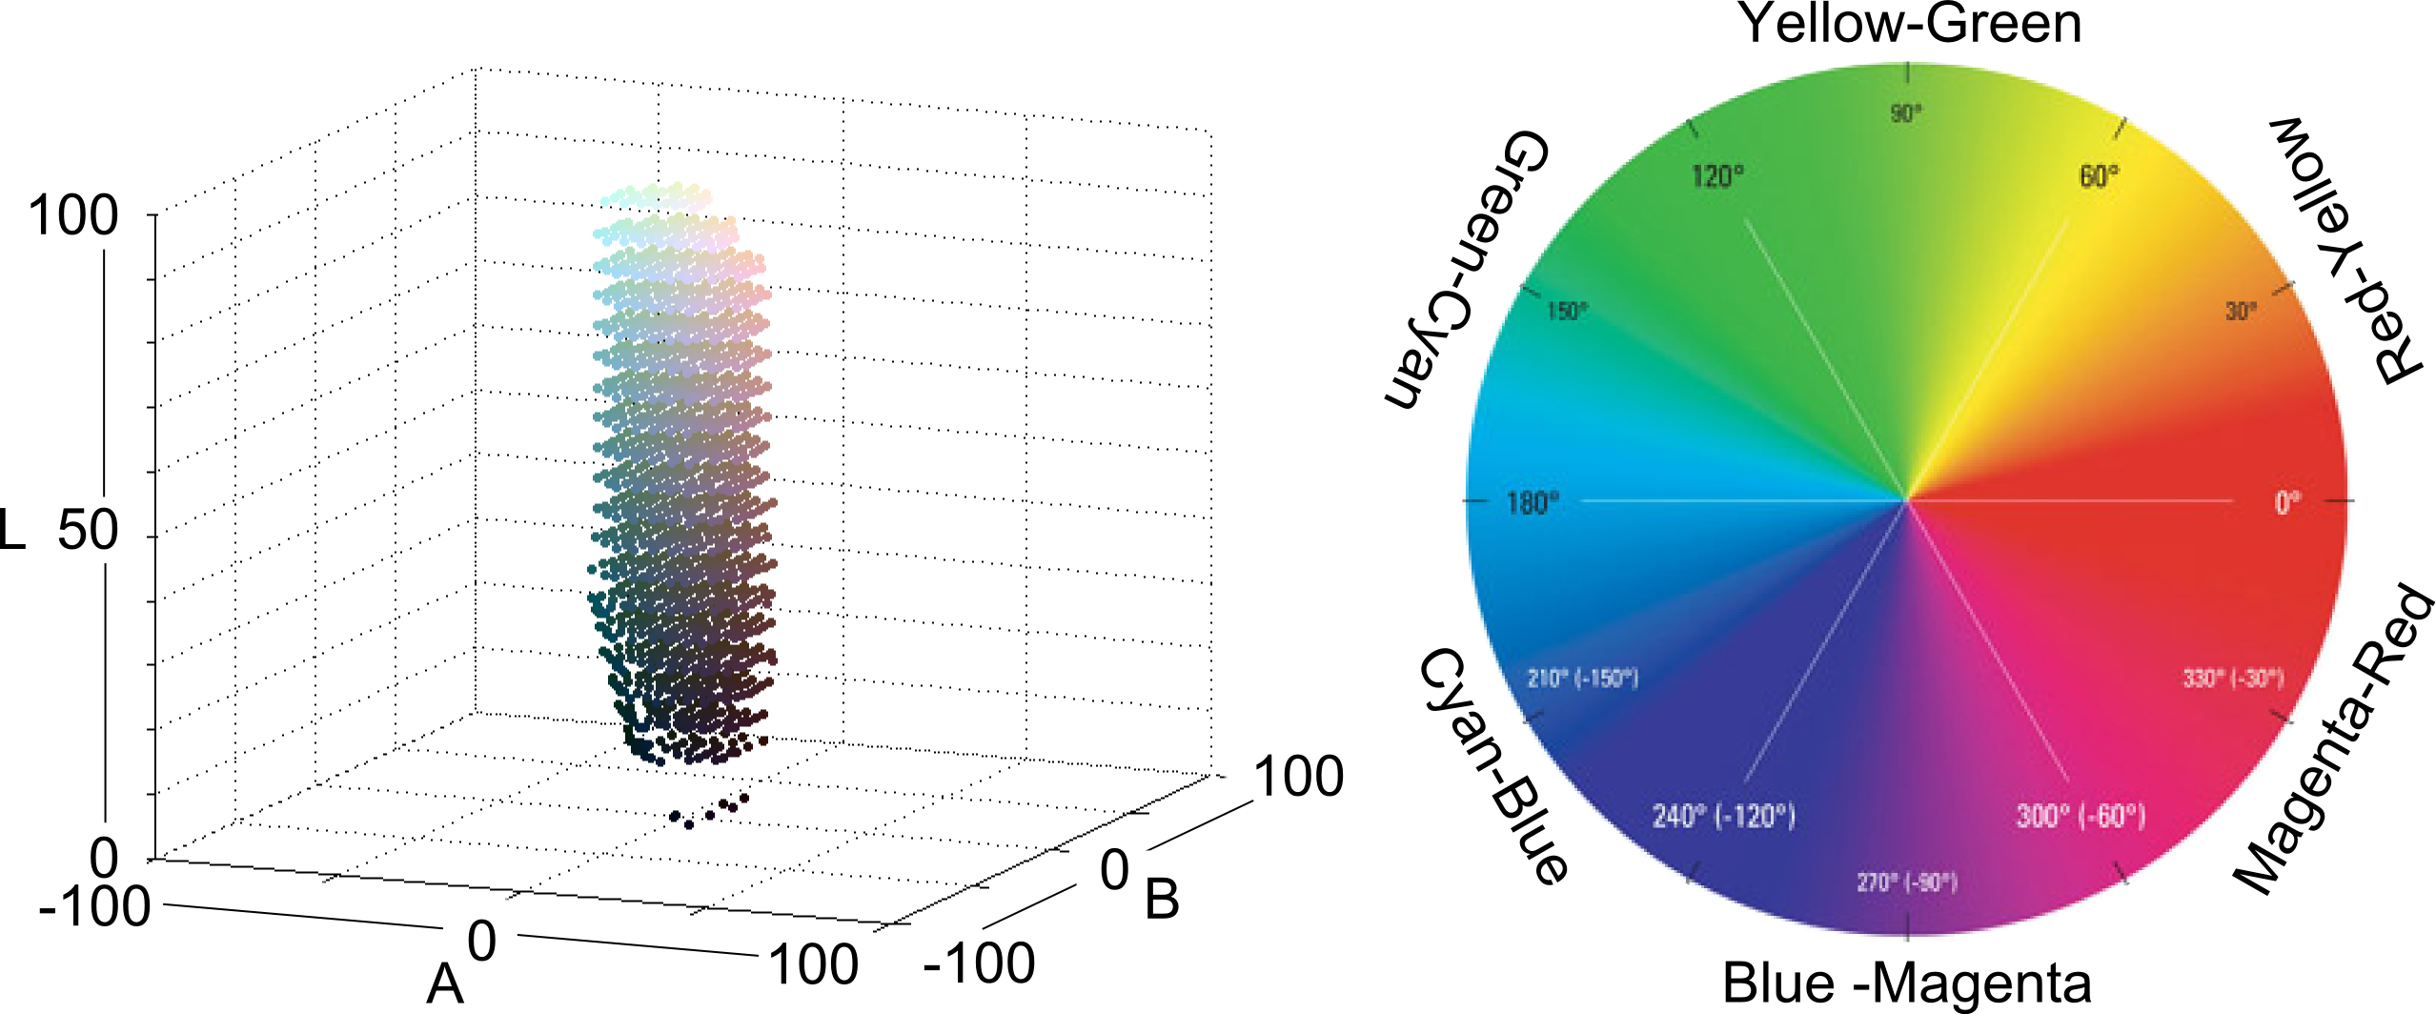
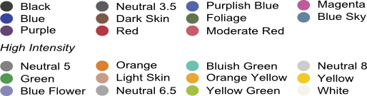
Color Analysis
10 groups:
Dark colors(L < 50), light colors (L >= 50)
Dark and light neutrals
6 chromatic regions
Low Intensity
Notes:
10 groups:
Dark colors(L < 50), light colors (L >= 50)
Dark and light neutrals
6 chromatic regions
Same way we divided
Bg into low intesity and high intensity bg,

Slide 30
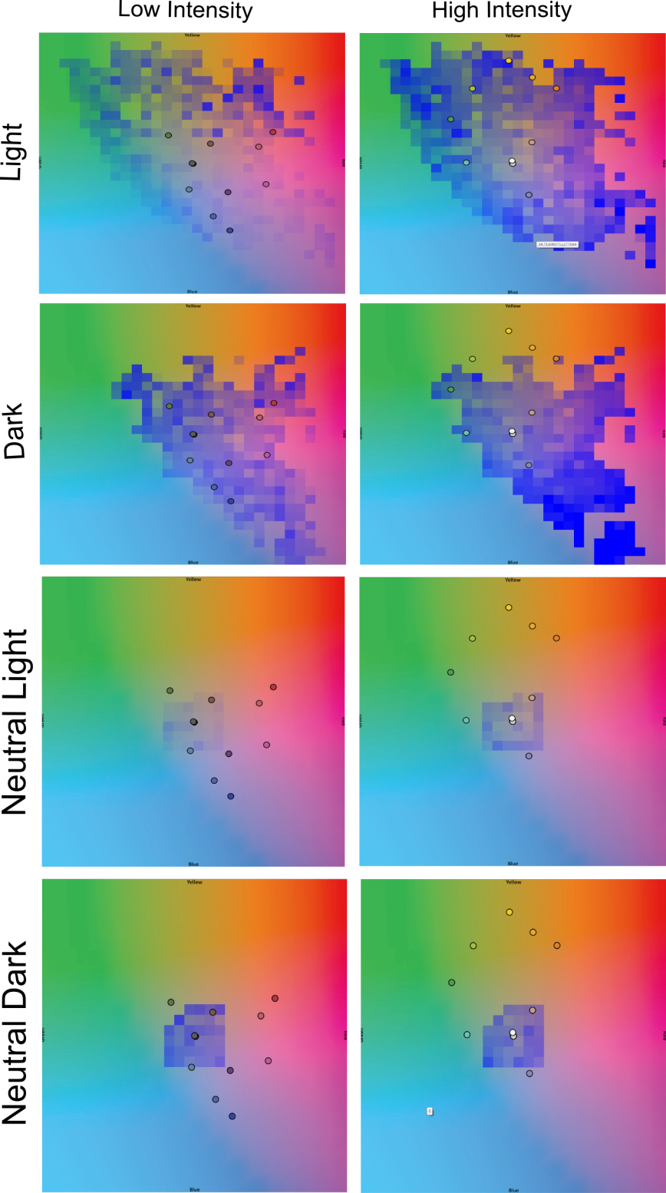
Notes:
Don correction we generally found light color were corrected better than dark colors for both high and low intesity bg
Color values near the edge of the gamut suffered a the most error in correction
Dark colors under high intensity bg were hardest to correct.
We generally found colors at the center of the gamut to have low correction error.
This is were the neutrals are present at , on analysing them we found both light and dark nuterals have low error rate for correction on both the bg

Slide 31
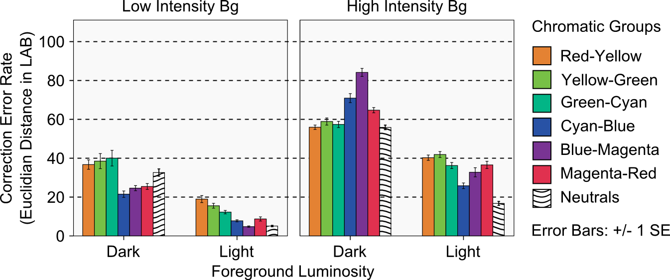
Quantitative Analysis
Kruskal-Wallis test was done, Sig <0.001
Notes:
We generally found neutrals to have low error rate, other than that we found light colors in cyan blue region preforming consistently better among all the other color regions across the bg.
All colors in light region performed better on dark bg
Dark colors in high intensity bg performed the worst !!

Slide 32
Research Implication

Slide 33
Design Implications
Use light neutral colors for information that needs to be preserved best
If more hue is needed, designers can use light colors in the Cyan-Blue region
Dark colors should be avoided for text and color-encoded information
Usage of color themes based on the background will be wise
Notes:
A UI designer for OSTD show keep following points in mind
Use Light neutral colors for information that needs to be preserved best (text , icons etc)
If more hue is needed, designers can use light colors in the Cyan-Blue region (alerts)
Dark colors should be avoided for text and color-encoded information
Usage of color themes based on the background will be wise
Have in mind there we are not recommending these to preserve contrast we are more concern about color

Slide 34
Hardware Implication
Is smaller display profile better?
Lower transparency, For OSTD?
Usage of SLM?
Notes:
However, such limited color
displays provide a limited color experience for applications like
video or game playing. On the other side, full color displays like
our p3700 could provide richer color experiences at the cost of less
correction accuracy.
Lower transparency
darkens background colors which, as we observed in the correction
study in T-OLED display, might be better suited for color correction.
The degree of display opacity poses a challenge for how much
accessibility and clarity is needed for either the background or the
display content, and remains an open question.
Ideally, an optical
see-through display should provide a way to control the level
of transparency at a pixel level, as explored by [Kiyokawa et al.
2003]. A rendering pipeline could rely on BP-based color correction
for darker backgrounds and block background light as the correction
algorithm approaches its limits

Slide 35
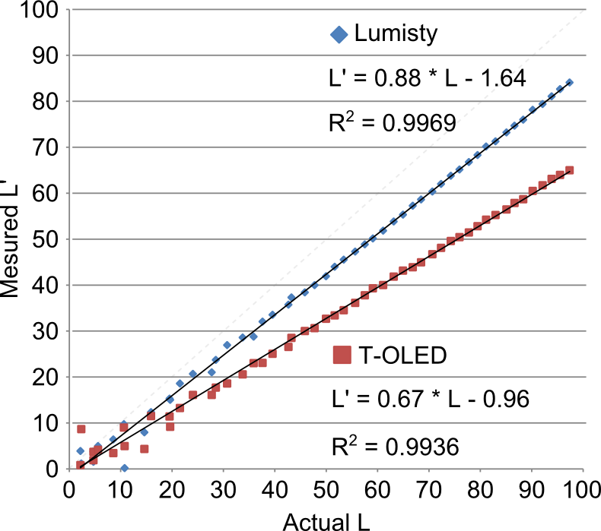
Practical Implication
Usage of camera to capture the background?
How to capture account for the Material Distortion?

Slide 36
Future Work
Notes:
We are currently working on a algorithm which is not brute force.
Also working to implement this on a HMD

Slide 37
Take Away
Use color themes for displaying Contents on OSTD
Render distortion must be handled for color related study
Research is needed in the area of BG color capture

Slide 38


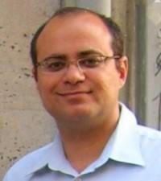

Acknowledgements
Dr. Juan David Hincapié-Ramos
Dr. Pourang Irani
Dr. David R. Flatla
Special thanks to Jango Guo
NSERC for funding and people at HCI lab In university of Manitoba

Slide 39

Thank you, Questions?
Presented by,
Srikanth Kirshnamachari Sridharan

Slide 40
Annexure

Slide 41
Step 1: Foreground Look up
Binned Profile
Foreground
Measured foreground
Desired foreground
Foreground to show
Notes:
This explains the working of the algorithm
First show that how system wants to show the color
And how its mapped to a custom gamut ,where each color is indexed to its source in sRGB
Once we know what Ci is , we look up in this table where it can give the corresponding RGB in custom space ,
Then on know this and the BG we can find Cp.

Slide 42
Step 2: Color Blend Prediction
Binned Profile
Measured foreground
Prediction
Foreground
Adjusted Background
Notes:
First show that how system wants to show the color
And how its mapped to a custom gamut ,where each color is indexed to its source in sRGB
Once we know what Ci is , we look up in this table where it can give the corresponding RGB in custom space ,
Then on know this and the BG we can find Cp.

Slide 43
Step 3:Prediction Comparison
Binned Profile
Measured foreground
Prediction
Foreground
Foreground to show
Difference in LAB
Notes:
First show that how system wants to show the color
And how its mapped to a custom gamut ,where each color is indexed to its source in sRGB
Once we know what Ci is , we look up in this table where it can give the corresponding RGB in custom space ,
Then on know this and the BG we can find Cp.

Slide 44
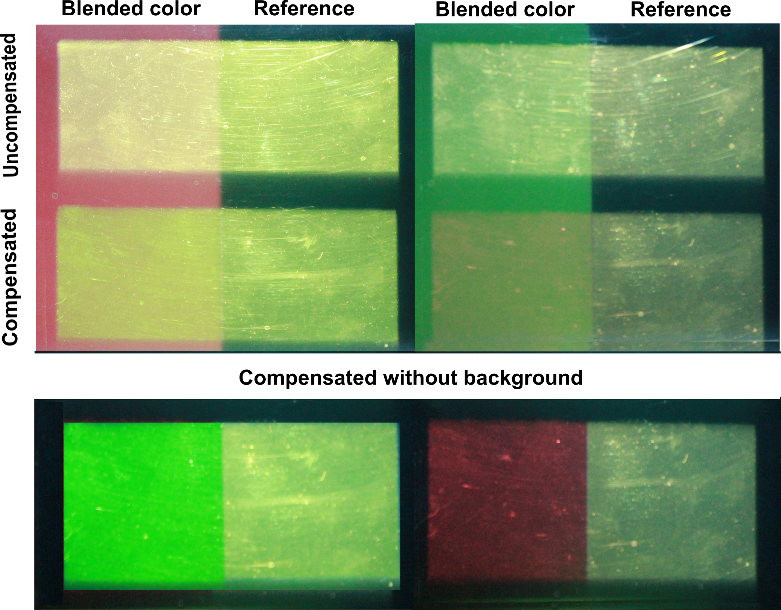
Notes:
Example of the system working

Slide 45
Notes:
Cat fg colors

Slide 46
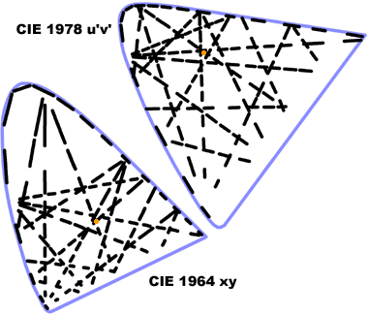
Just Noticeable Difference
Notes:
JND is the Euclidian distance between 2 given color in a color space with in which the colors appear same to humans.
In XYZ space it varies with each color, but in uniform spaces like LAB and LUV its constant number ( 2.5 in lab).

Slide 47
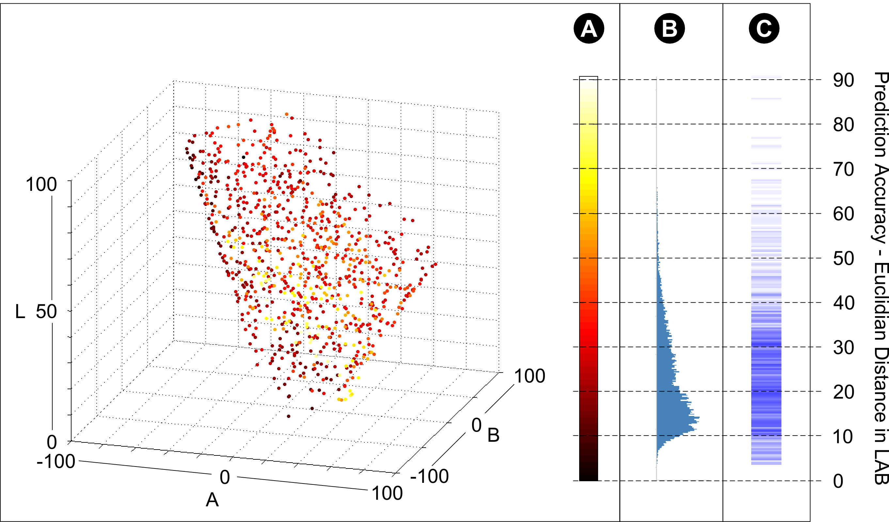
Result
Notes:
Prediction result viz

